Slide 1
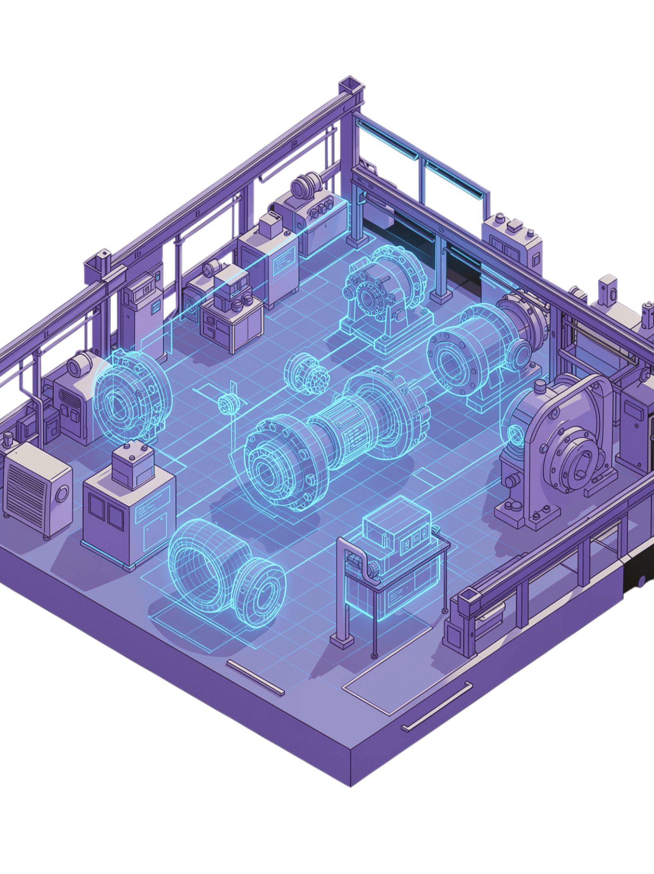
VisionInspect AI
AI-Based Manufacturing Defect Detection System
Milestone 1 Review · Presented by Murali Sankar Reddy

Slide 2
Project Overview
Field
Details
Milestone 1 Objectives
React Frontend
FastAPI Backend
MongoDB Integration
JWT Authentication
Role-Based Access
Image Upload
Dataset Integration
Project
VisionInspect AI
Domain
Smart Manufacturing
Objective
AI-based Product Inspection
Frontend
React + Vite
Backend
FastAPI
Database
MongoDB
AI
OpenCV, NumPy
Dataset
MVTec AD

Slide 3
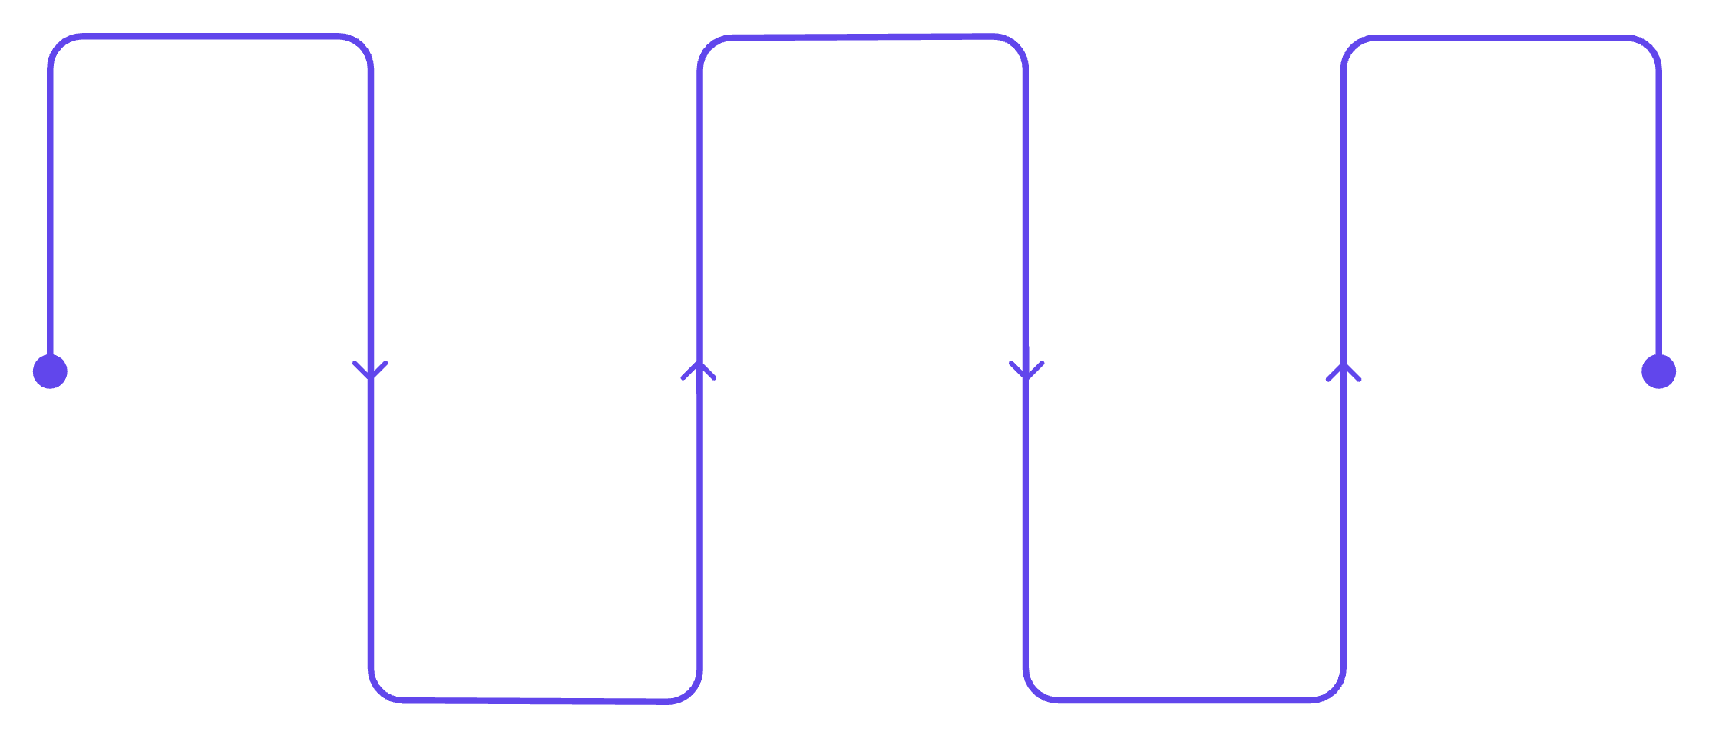
System Architecture
React Frontend
MongoDB
MVTec AD Dataset
Persistent storage for app data
User interface and client logic
Model training and evaluation data
FastAPI Backend
AI Module
API, auth and business logic
Inference and model orchestration
End-to-end architecture from user interface through backend, data storage, AI processing, and dataset support.
Technology Stack
Frontend: React, Vite, CSS, React Router
Backend: FastAPI, Python 3.11
Database: MongoDB
Authentication: JWT, Passlib, Bcrypt
AI Libraries: OpenCV, NumPy
Tools: Postman, MongoDB Compass, VS Code, Git

Slide 4
Database Design
Users Collection
Inspections Collection
Field
Type
Constraint
Field
Type
Constraint
_id
ObjectId
Primary Key
_id
ObjectId
Primary Key
name
String
Required
filename
String
Required
email
String
Unique
filepath
String
Required
password
String
Hashed (Bcrypt)
uploaded_by
ObjectId
References User
role
Enum
Quality Engineer / Factory Supervisor
uploaded_at
DateTime
Auto Generated
status
Enum
Pending / Completed
created_at
DateTime
Auto Generated
prediction
String
Nullable (Future AI Output)
confidence
Float
Nullable (Future AI Score)
Relationship
Users → (uploaded_by) → Inspections
MongoDB (NoSQL) Database
Secure user authentication using JWT
Inspection records linked to users
Designed for future AI prediction storage

Slide 5
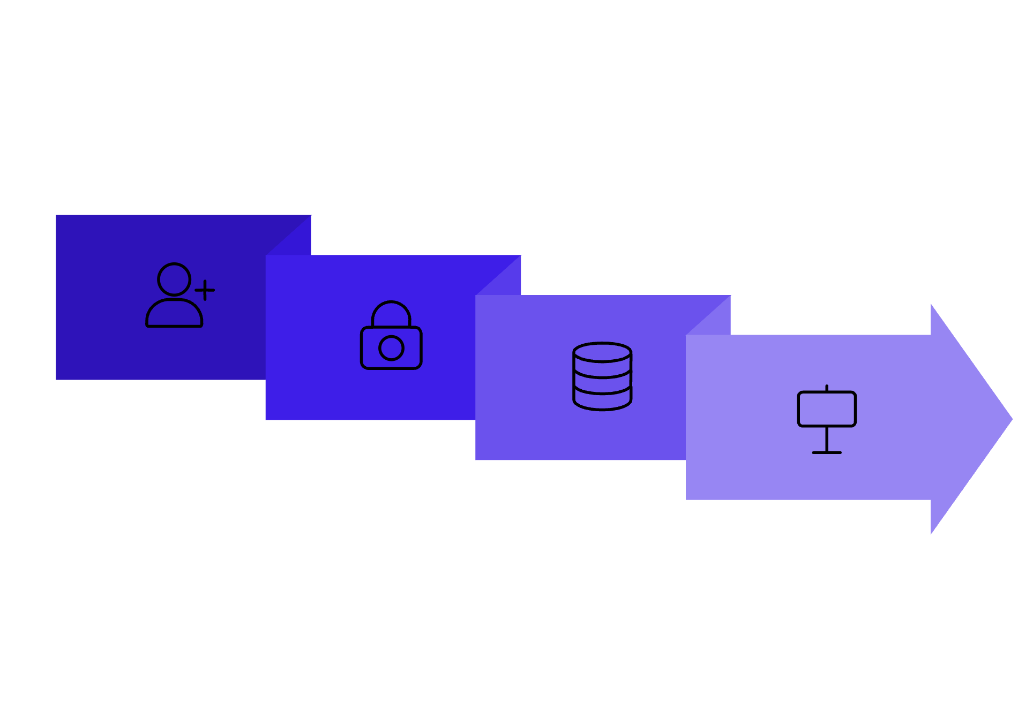
Authentication & Role-Based Access
Authentication Workflow
User Roles & Permissions
Quality Engineer
Image upload
Inspection results
History
Quality reports
Hash Password
Login
Factory Supervisor
Register
Production overview
Inspection reports
Analytics
User management
Store in DB

Slide 6


Image Upload Workflow
FastAPI Upload API
Upload Product Image
Backend endpoint
Login
File selection and upload
Quality Engineer
Authentication
User role
Inspection History
Save Inspection Metadata to MongoDB
Access results
Store Image in Uploads Folder
Validate Request
Store inspection details
Check image format and integrity
Save file to disk
The uploaded image and its metadata are securely stored in MongoDB and are ready for AI processing.

Slide 7

REST APIs & Workflow
Implemented Endpoints
Workflow
Endpoint
Method
Purpose
Upload Image
Send image to /inspection/upload endpoint.
Save to MongoDB
Persist image and metadata in database.
/auth/register
POST
Register User
/auth/login
POST
Login User
/inspection/upload
POST
Upload Image
User Login
Inspection History
Authenticate via /auth/login endpoint.
Retrieve records from /inspection/history.
/inspection/history
GET
Inspection History
Authenticated users upload images, the system saves inspection data to MongoDB, and history can be retrieved later.

Slide 8
Features Implemented
Quality Engineer Dashboard
Factory Supervisor Dashboard
Dashboard overview
Upload product images
View inspection results
Defect details and analysis
Inspection history tracking
Quality reports generation
Production overview
Inspection reports
Defect trend analysis
Quality analytics
Production monitoring
User management

Slide 9

Dataset Integration & Image Preprocessing
MVTec AD Dataset
Image Preprocessing Pipeline
Category
Train Images
Test Images
Bottle
209
83
Cable
224
150
Capsule
219
132
Load Image
Convert RGB
Resize 256×256
Normalize 0-1
Carpet
280
117
Screw
320
160
Purpose: Standardize inputs for AI model training and real-time inference.
Wood
247
79
Zipper
240
151

Slide 10
Project Demonstration
Milestone 1 Live Walkthrough — All Components Verified and Operational
Login Page
Quality Engineer Dashboard
Secure JWT authentication with role detection
Image upload and inspection management
Factory Supervisor Dashboard
MongoDB Compass
Production analytics and reporting
Database collections and data verification
Postman API Testing
Inspection History
Endpoint validation and response verification
Historical data tracking and retrieval
Milestone 1 Successfully Completed

Slide 11
Thank You

